Slide 1


New Theatres of Nature

Slide 2
The discovery of smallness
One interesting expression of the bias due to the reliance on common sense is the belief (which was universal during the Middle Ages and Renaissance) that small organisms (e.g., fleas, lice)that are on the very threshold of sensation are structurally insignificant.
Ordinary observation reveals that many organisms (e.g., horse, cat) are complicated with many moving parts, and so this bias supported the belief that smallness is synonymous with simplicity.
Prior to the invention of the microscope, the world was not much interested in tiny organisms at the very threshold of sensation; these organisms were pests but nothing more. Small things were petty and insignificant.

Slide 3
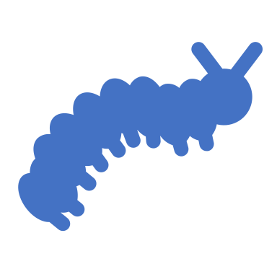
The Doctrine of Spontaneous Generation
The scientific expression for this idea (which was the by-product of the authority conferred on ordinary sensation) that smallness is insignificant is the doctrine of spontaneous generation, which held that smallness is not an obstacle to generation.
Indeed, if one was to “Collect a number of fly cadavers and crush them slightly. Put them on a brass plate and sprinkle the macerate with honey-water… you will see… otherwise invisible worms, which then become winged, perceptible little flies, and increase in size to animated full-fledged specimens.” So said Athanasius Kircher in 1668, a Jesuit natural philosopher, echoing the wide spread belief at the time that flies (among many other small organisms, did not breed but arose out of inert material.

Slide 4
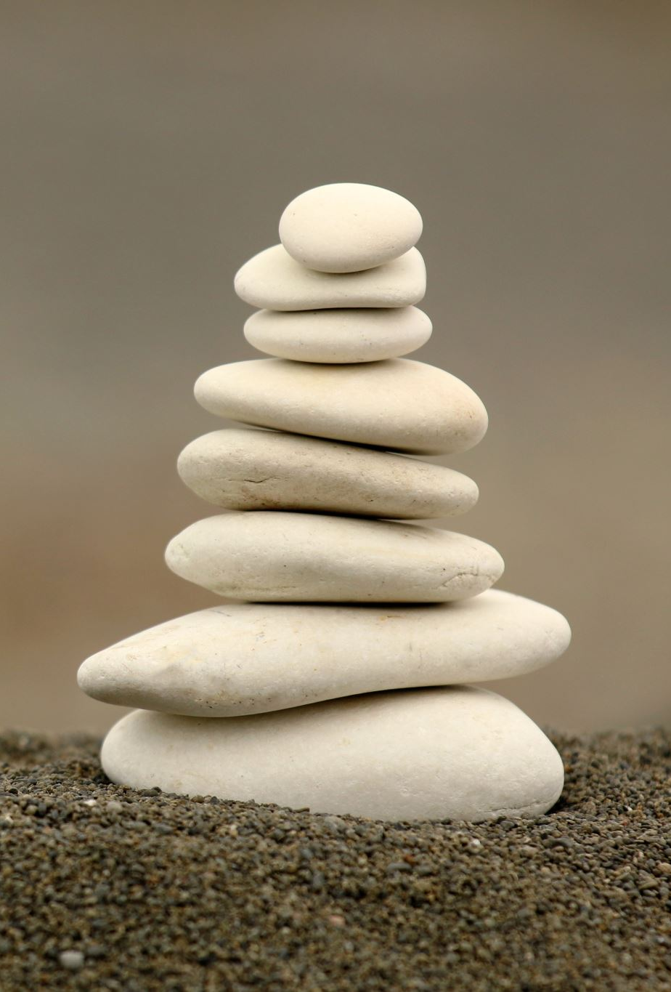
The doctrine of spontaneous generation can be traced to Aristotle, and during the Renaissance it was widely believed that ants formed out of sour wine, worms from soil, and household pests like lice, fleas and bedbugs from human sweat.
The work of the microscopists (Leeuwenhoek, Hooke) challenged this doctrine but did not overthrow it.

Slide 5
Complicated vs complex
A complicated system is one that is built in a mechanical fashion out of simple systems. If we understand the laws that govern a simple system, we can reduce the laws that govern the complicated system to a simple system.
A complex system cannot be reduced to a simple system: complex systems feature properties that emerge at different levels of organization.

Slide 6

The marginalization of Robert Hooke
Almost unrivalled number of inventions, including the air pump that is usually credited to Robert Boyle.
Expertise across a range of scientific fields.
Exceptional artist and architect.
Gave Newton the suggestion that the best explanation for an elliptical orbit would be an inverse square force. Also, gave Newton the suggesrion that the planet’s motion should be understood in terms of a centripetal (attractive) force.
Nevertheless, he is remembered as ingenious, in part because he did not make major contributions to mathematical subjects. Ingenious is a reference to labour with one hands, which epistemically was regarded as an inferior way of knowing.

Slide 7
The Gray Drone fly
The fly has more than 1900 hundred different segments (Hooke counted them). The fly can see in 360 degrees; here the laws of linear perspective do not hold. His optical apparatus is far superior to our own. His apparatus is “sophisticated.”

Slide 8
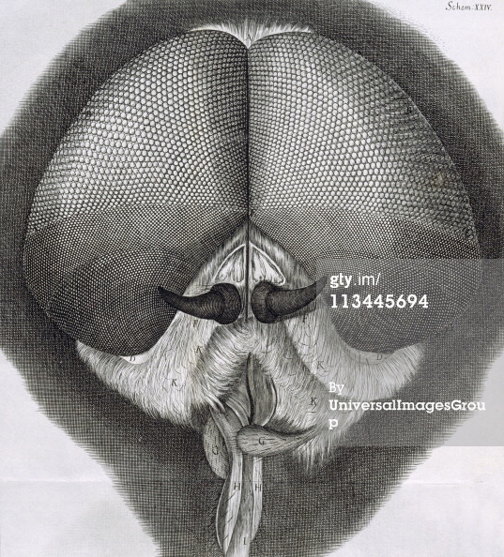
Hooke, Gray Drone Fly (Micrographia)

Slide 9
The Flea
Hooke does not tell his reader what kind of flea he is picturing. He was not interested in comparative anatomy and there is no evidence that he was aware that there are kinds of fleas (i.e., species adapted to humans, cats, dogs, rats, etc.).
Also, compare Hooke’s picture with a photo of a flea using a modern compound microscope. The flea is ordinarily transparent, whereas Hooke’s flea looks armored. The reason is that he dipped his insect specimens in brandy to stop them from moving which, in turn, stained them and gave the appearance of a hard body.

Slide 10
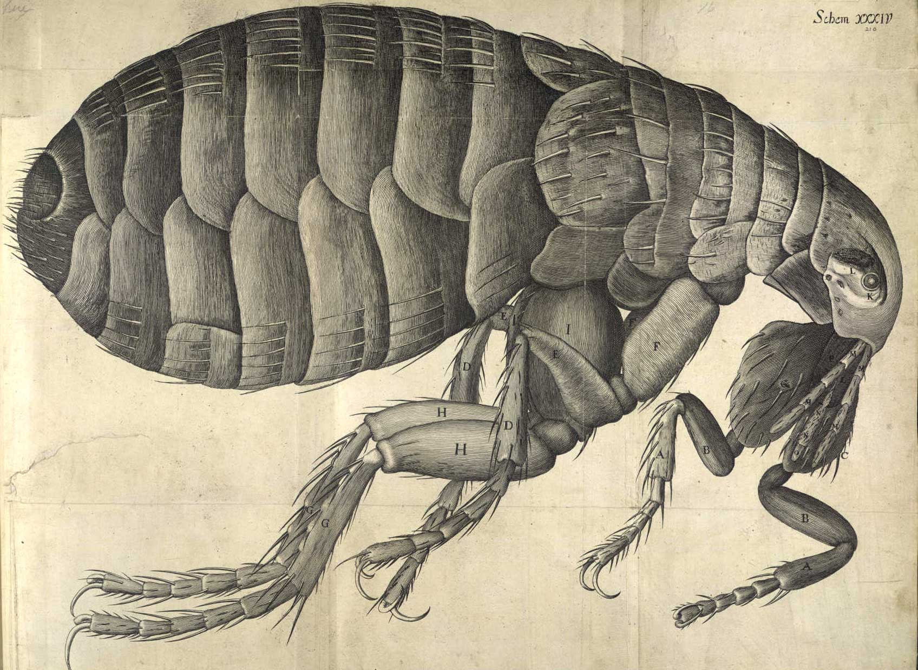
Hooke, Flea (Micrographia)

Slide 11
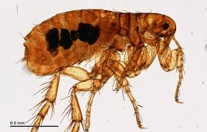
Rat flea, infected with Yersinia pestis

Slide 12
The flea (continued)
Now look at the photo of a rat flea that is infected with the bacterium that causes plague. Note that London endured the Great Plague during the years 1664-65, which killed a quarter of its population (estimated at 600,000 people).
Hooke’s flea appears to be a rat flea (though Hooke is insensitive to this and does not say where he obtained his sample).
He would not have been able to visualize the infection in the flea’s gut due to his method of processing his specimen.
He would not have been sensitive to the thought that an individual organism can be the host to other organisms.

Slide 13
Structure
As useful as Hooke’s microscope was as a tool of observation, the fact is that much of what he reported could have been seen with the unaided eye. Hooke’s microscope revealed this complexity in all its detail but the complexity itself was there to be seen. So why did it escape everyone’s attention?

Slide 14
Leeuwenhoek’s simple microscope
Leeuwenhoek was a draper who was accustomed to examining cloth for signs of “sophistication.”
He started making his own simple microscopes.
His microscopes have a magnifying power of some 270 times.

Slide 15
Leeuwenhoek and the Mechanical Philosophy
The guiding principle of the mechanical philosophy: life and mobility are identical.
With his microscope, Leeuwenhoek concluded that the moving objects he saw through his micro­scope were little animals.
He communicated his observations to the Royal Society in 1676, where they caused a sensation. In subsequent letters, he described many specific forms of microorganisms, including bacteria, protozoa, as well as his accidental discovery of ciliate reproduction. These organisms were hitherto invisible (new theatre of nature).
He also devised a scale to measure this formerly invisible world; his system of micrometry utilized as standards a grain of course sand, a hair from his beard, and bacteria in pepper water.

Slide 16
Sexual reproduction
Leeuwenhoek observed spermatozoa.
One explanation for these animalcules is that they were the product of putrefaction.
Leeuwenhoek insisted that they were a naturally occurring phenomenon, and set out to show that spermatozoa were universally found in nature. Dissected thousands of organisms in order to make this point.

Slide 17
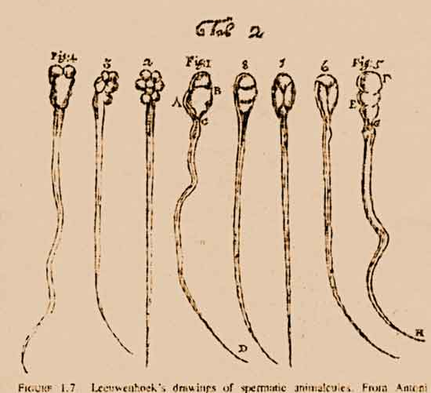
Spermatozoa (Leeuwenhoek)

Slide 18
Animalculism
Leeuwenhoek advanced a new theory of the fertilization process. Having observed spermatozoa, he was able to proceed beyond the prevailing belief that fertilization occurred from vapours arising out of the seminal fluid. He postulated that the spermatozoa actually penetrate the egg, even though he was unable to observe this process.
Assuming that the fast moving spermatozoa were the origin of all new animal life (since he equated life with mobility), he went on to state that the egg and the uterus nourished the new life. He thus denied any generative role to the motionless (and therefore lifeless) egg, and placed himself in direct opposition to those like William Harvey who held the egg to be the source of all new life. Leeuwenhoek thus arrived at an animalculist theory of reproduction.

Slide 19
A critical case was the reproduction of mammals. Following Harvey, the self-described “ovists” thought that the ovary follicle (membrane covering the sac which contains the egg) was in fact the egg, while Leeuwenhoek pointed out that it was impossible for the entire follicle to pass through the narrow fallopian tube to the uterus.
The actual mammalian egg was not found until 1832, and the ovist-animalculist controversy persisted until 1875 or so when it was demonstrated that fertilization represents the fusion of the nuclei of the spermatozoa and the egg.

Slide 20
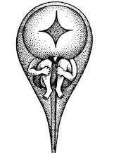
Homunculus (Preformation Theory)

Slide 21
Transmission of forms
The reigning metaphor for what we now think of as the communication of information.

